Slide 1
Polly Williams period 6
Comparing Governments

Slide 2
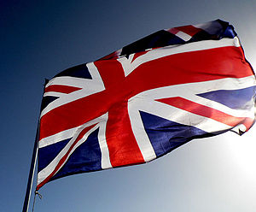
United States | United Kingdom
Type of government

Slide 3
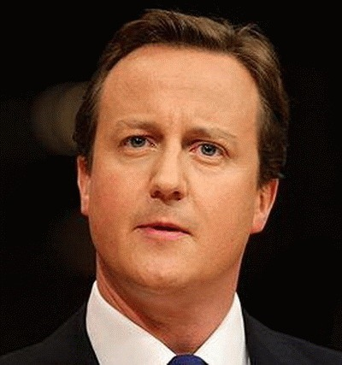
TITLE OF LEADER NAME OF CURRENT LEADER ELECTED OR APPOINTEd LENGTH OF TERM BACKGROUND/ QUALIFICATIONS REQUIRED | UNITED STATES President Barack Obama Elected 4 years each term. Can serve 2 terms. Natural born citizen , or citizen of US. Must be a resident of US for 14 years. 35 years of age or older. Can not be elected more than twice. | UNITED KINGDOM Prime minister David Cameron Appointed No term limits Become an MP. Become leader of your party. Your party wins general election.
Prime minister
of United Kingdom
Type of government

Slide 4
The United Kingdom is a constitutional monarchy and parliamentary democracy, with a queen and a parliament that has two houses: the House of Lords, with 574 life peers, 92 hereditary peers, and 26 bishops; and the House of Commons, which has 651 popularly elected members. Supreme legislative power is vested in parliament, which sits for five years unless dissolved sooner. The House of Lords was stripped of most of its power in 1911, and now its main function is to revise legislation. United Kingdom: Maps, History, Geography, Government, Culture, Facts, Guide & Travel/Holidays/Cities | Infoplease.com http://www.infoplease.com/ipa/A0108078.html#ixzz2SWfUMlRl
type of government

Slide 5
United Kingdom has been a beacon for free expression when compared to the rest of the world.
The right to Freedom of religion in the United Kingdom is provided for in all three constituent legal parts.
They have the right to bear arms unless a felon.
Type of government

Slide 6
United Kingdom
multiparty system.
Labour, Conservative and Liberal Democrat.
Political parties

Slide 7
To vote in a UK general election a person must be registered to vote and also:
be 18 years of age or over on polling day
be a British citizen, a qualifying commonwealth citizen or a citizen of the Republic of Ireland
not be subject to any legal incapacity to vote
General elections are held at least every five years.
Not all Parliaments run for the whole five years.
A general election may be held before this period is up.
In the event of a government having a small majority the election may well take place much earlier

Slide 8
The UK has VAT (value added tax) on all good, though some basics are exempt like kids shoes, milk etc.
Income tax is taken straight of wages each month along with National Insurance which goes towards the NHS (national health service). The rate of tax depends on how much they earn.
Exports of both goods and services.

Slide 9
According to the UK government, there were 1.94 million violent crimes in the UK during 2011.
There are almost exactly five times as many people in the US as in the UK – 314 million vs. 63 million.
The violent crime rate in the UK is 3,100 per 100,000, and in the US it is 380 per 100,000 population.
the UK prison population stands at around 97,000

Slide 10
Today, the relationship with the United States represents the "most important bilateral partnership" in current British foreign policy and the American foreign policy. Its relationship with the United Kingdom as its most important bilateral relationship as evidenced in political affairs, mutual cooperation in the areas of trade, commerce, finance, technology, academics, as well as the arts and sciences; the sharing of government and military intelligence, and joint combat operations and peacekeeping missions carried out between the USAF and the BAF. The UK has always been the biggest foreign investor in the USA and vice versa.

