Slide 1
DAHS Graduation Project
By: Pollyanna Williams

Slide 2
THE ENGLISH FLAG
The meaning of the English flag is a blue field with the red cross of Saint George (patron saint of England) outlined in white on the diagonal red cross of Saint Patrick (patron saint of Ireland), which is superimposed on the diagonal white cross of Saint Andrew (patron saint of Scotland)

Slide 3
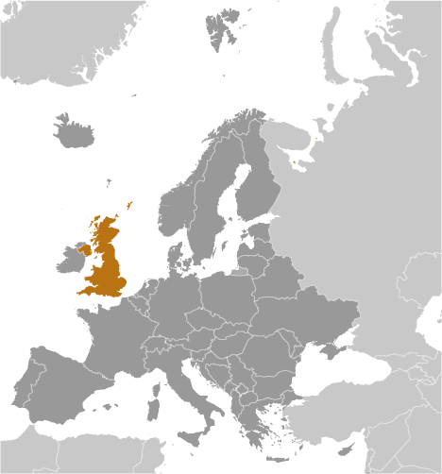
UNITED KINGDOM
Capital: LONDON

Slide 4
The United Kingdom’s population as of July, 2010 is 62,348,447.
United Kingdom is ranked 22 with the other countries of the world.

Slide 5
UK life expectancy
total population: 79.92 years
comparison to the world: 28
male: 77.84 years
female: 82.11 years (2010 est.)

Slide 6
The largest religion group in the UK would be Christianity.
Christianity believes in one God, while the central figure in Christianity is Jesus (or Christ), a Jew who came into this world by the immaculate conception of the virgin Mary. His birth is celebrated at Christmas with gift giving. It's believed that Jesus was not only man, but also the son of God and lived his life without sin

Slide 7
The language spoken by people in the United Kingdom
is English. Five basic phrases are..
Hello
How are you?
Thank you.
Good morning.
Goodnight.

Slide 8
We celebrate Christmas because it is the rejoice of the birth of Baby Jesus.
It is a time of gathering and gift exchanging. We spend time with our loved ones and
have a Christmas dinner.

Slide 9
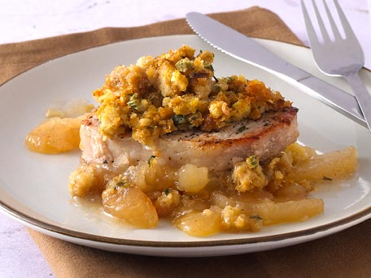
Pork Steaks With Apple Rings
Ingredients: 4 of 10 oz (4 of 275 g) Pork Steaks ground black pepper 2 oz (50g) soft brown sugar 4 tablespoons english mustard 4 apple rings* 8 large rashers of smoked bacon sweet cider salt (to taste)
Method: 1. Remove any skin/rind from the pork steaks. 2. Barbecue the steaks for about 3 or 4 minutes on each side. 3. Allow the steaks to cool. Then coat them with the English mustard. Onto this coating sprinkle a little soft brown sugar and then place an apple ring on top. 4. Now wrap each steak in bacon. Sprinkle a little salt and course ground black pepper onto the outside. 5. Barbecue each steak for another 3 minutes on each side. 6. As these steaks cook, sprinkle a little sweet cider onto them.

